Slide 1
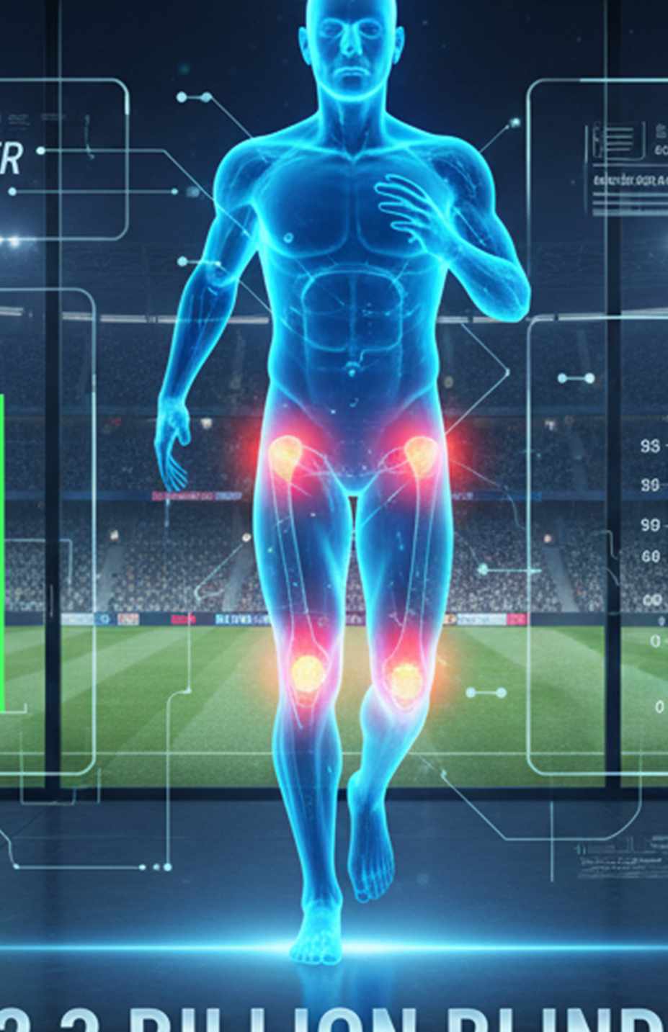

Sports Injury Risk Prediction System
Using Machine Learning to Prevent Athletic Injuries
Priyanshu Mukherjee,Deevi Sree Narayan,Ishhan Agarwal | Final Project
Notes:
1.7.2013
1.7.2013
‹#›
‹#›
‹#›

Slide 2
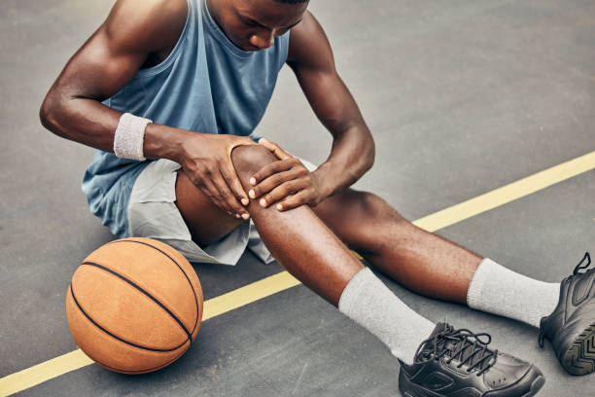




Why This Matters ? (Problem Statement)
The Reality of Sports Injuries
Athletic injuries significantly impact performance, careers, and team success. Many of these injuries are preventable with early detection and proper intervention.
Current assessment methods rely heavily on manual evaluation and subjective judgment, creating gaps in prevention strategies.
Automated System
Early Detection
Data-Driven Predictions
Scalable prevention through machine learning
Identify at-risk athletes before injury occurs
Remove subjectivity from risk assessment
Notes:
1.7.2013
1.7.2013
‹#›
‹#›
‹#›

Slide 3
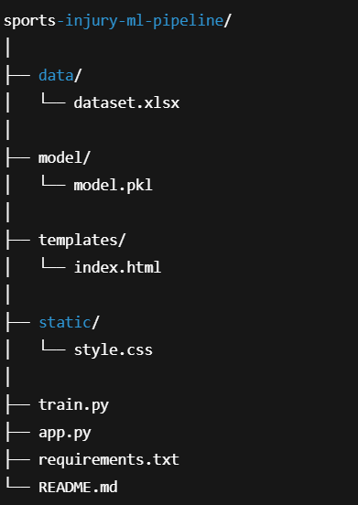






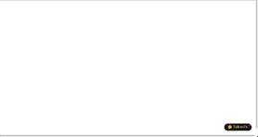

System Architecture
Full-stack implementation connecting data science with practical application
User Interface
Web form captures athlete metrics
Flask Backend
Input validation & processing
ML Model
Random Forest prediction engine
Results Display
Risk score & probability output
Model Persistence
Trained model saved as injury_model.pkl for deployment
API Ready
Backend provides JSON endpoints for mobile and dashboard integration
Notes:
1.7.2013
1.7.2013
‹#›
‹#›
‹#›

Slide 4
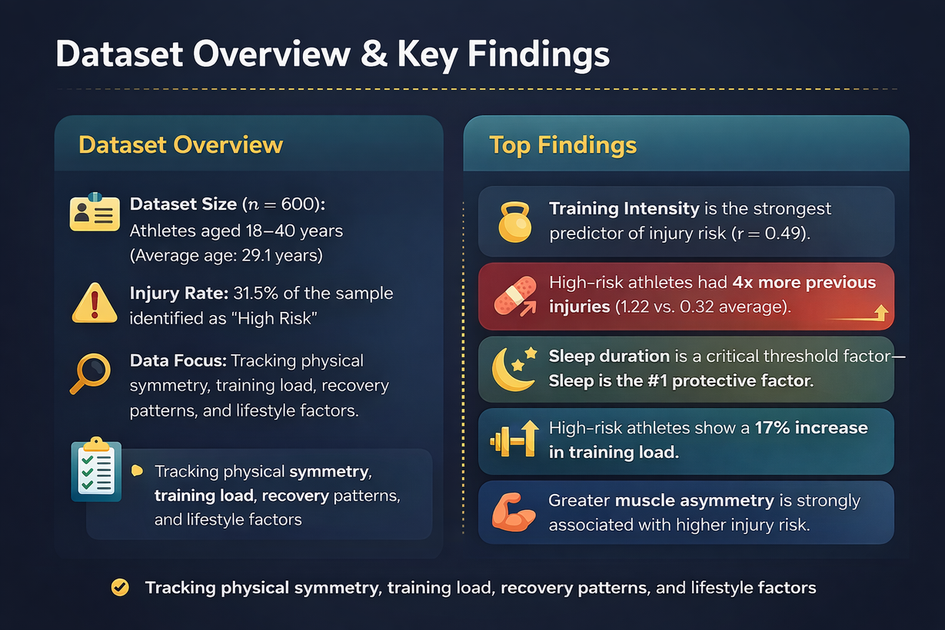
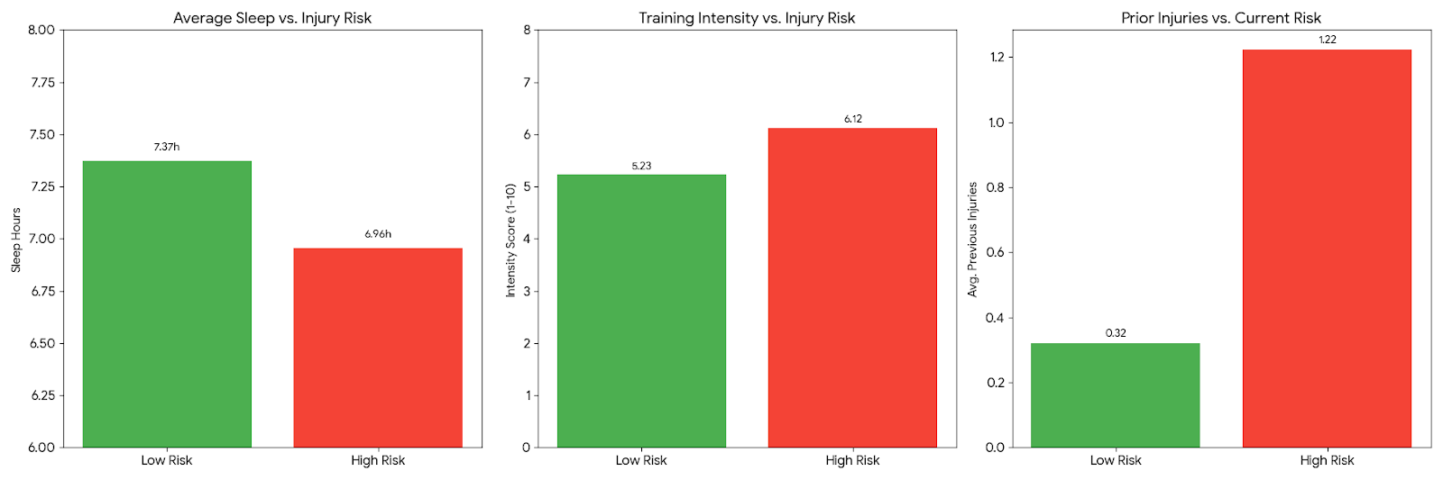
Dataset Foundation
Metric | Low Risk Group | High Risk Group | Difference
Average Sleep | 7.37 Hours | 6.95 Hours | - 25 Minutes
Training Intensity | 5.23 / 10 | 6.12 / 10 | + 17% Intensity
Prev. Injuries | 0.32 | 1.22 | + 280% History
Notes:
1.7.2013
1.7.2013
‹#›
‹#›
‹#›

Slide 5


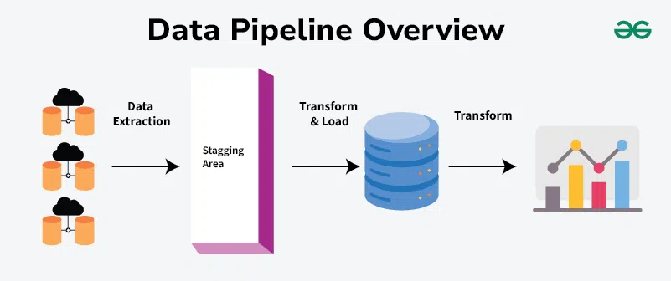
Data Processing Pipeline
train.py Implementation
Data Loading & Selection
2
Target Definition
3
Stratified Train-Test Split
1
Pandas framework loads dataset and filters 15 relevant features for model training
Injury_Risk column established as prediction target for supervised learning
Training: 80% | Testing: 20% with random_state = 42 ensuring reproducible results
Stratification Benefits
Maintains balanced class distribution across training and test sets, ensuring representative sampling of both high-risk and low-risk injury cases.
This technique improves model reliability by preventing class representation bias.
Notes:
1.7.2013
1.7.2013
‹#›
‹#›
‹#›

Slide 6






Random Forest Model
Ensemble learning approach combining multiple decision trees for robust predictions
Ensemble Method
Multiple decision trees vote on final prediction, reducing variance and improving accuracy
Built-in Validation
Out-of-bag samples provide internal error estimation without separate validation set
Nonlinear Relationships
Handles complex interactions between training load, recovery, and injury risk
Variability Control
Random feature selection at each split prevents overfitting to training data
Training Methodology
GridSearchCV Optimization
Evaluation Metrics
5-fold cross-validation systematically explores hyperparameter combinations to maximize performance
Accuracy
Recall
Precision
F1 Score
Notes:
1.7.2013
1.7.2013
‹#›
‹#›
‹#›

Slide 7
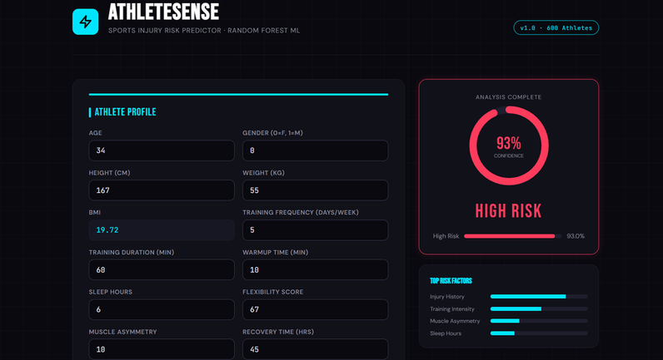
Frontend Interface
index.html User Experience
01
02
Dynamic Input Fields
Real-Time Validation
All 15 athlete metrics presented in logical categories with appropriate input validation
Input sanitization prevents invalid entries and ensures data quality before prediction
03
04
Visual Results Display
Dashboard Metrics
Clear risk label visualization with dual probability indicators (High Risk %, Low Risk %)
Additional athlete performance context shown alongside risk assessment
Input Validation
Probability Display
Range checks ensure values fall within acceptable physiological and training parameters
Percentage breakdown shows confidence in prediction for interpretability
Notes:
1.7.2013
1.7.2013
‹#›
‹#›
‹#›

Slide 8
Flask Backend API
Production-ready implementation for web and mobile integration
Model Loading
Pickle serialization enables efficient model persistence and fast inference on new samples.
Input Validation
Range checking ensures all 15 features fall within acceptable physiological boundaries before prediction.
Web Interface
JSON API
"/"
"/api/predict"
HTML form for manual data entry and result visualization
Structured predictions for mobile apps and dashboard integration
API Response Structure
{
"prediction": 1,
"risk_level": "High Risk",
"probability_high": 78.5,
"probability_low": 21.5,
"recommendation": "Review training load and recovery"
}
Integration Benefits: RESTful endpoints allow mobile applications, sports performance dashboards, and training systems to access injury risk insights programmatically.
Notes:
1.7.2013
1.7.2013
‹#›
‹#›
‹#›

Slide 9

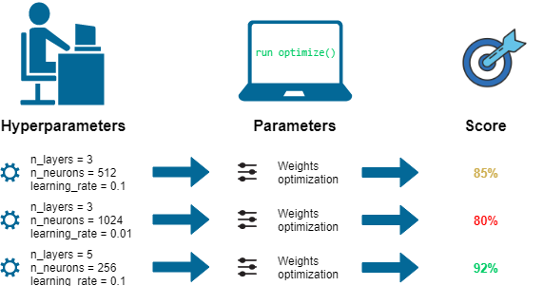



Hyperparameter Optimization
Tuned ensemble model settings to maximize predictive performance
Tree Ensemble Size
1
n_estimators: 100, 200
Number of decision trees in the forest. Values tested: 100 and 200
Tree Depth Control
2
max_depth: None, 10, 20
Maximum depth of each tree
Split Criteria
3
min_samples_split: 2, 5
Minimum samples required to split internal nodes
Class Balance
4
class_weight: balanced / None
Addresses class imbalance through weighted importance
Generalization
Optimized F1
Reduced overfitting through parameter tuning
Maximized weighted harmonic mean of precision and recall
Robust Performance
Improved cross-validation score consistency
Notes:
1.7.2013
1.7.2013
‹#›
‹#›
‹#›

Slide 10
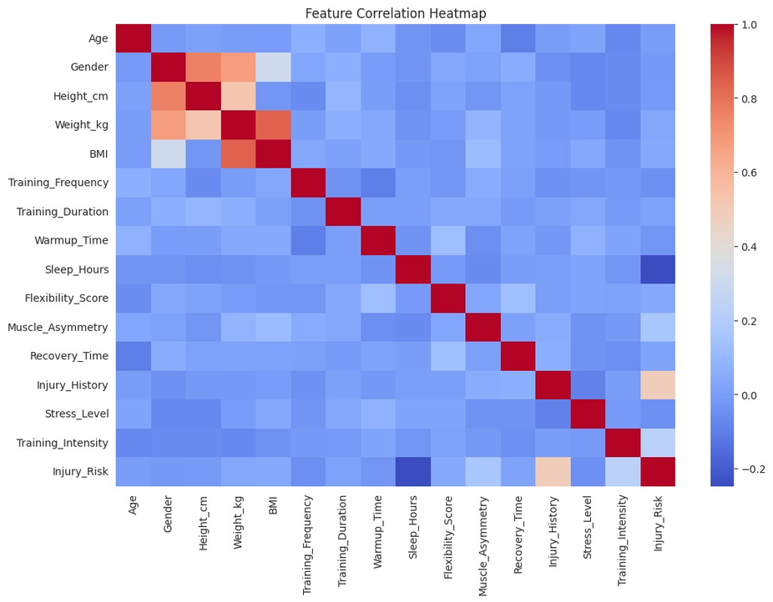
Data Visualisation
Heat Map
plt.figure(figsize=(12,8))
sns.heatmap(data.corr(), cmap="coolwarm", annot=False)
plt.title("Feature Correlation Heatmap")
plt.show()
• The heatmap shows relationships between all athlete features and injury risk.
• Injury history, training intensity, and recovery time show stronger correlation with injury risk compared to other variables.

Slide 11
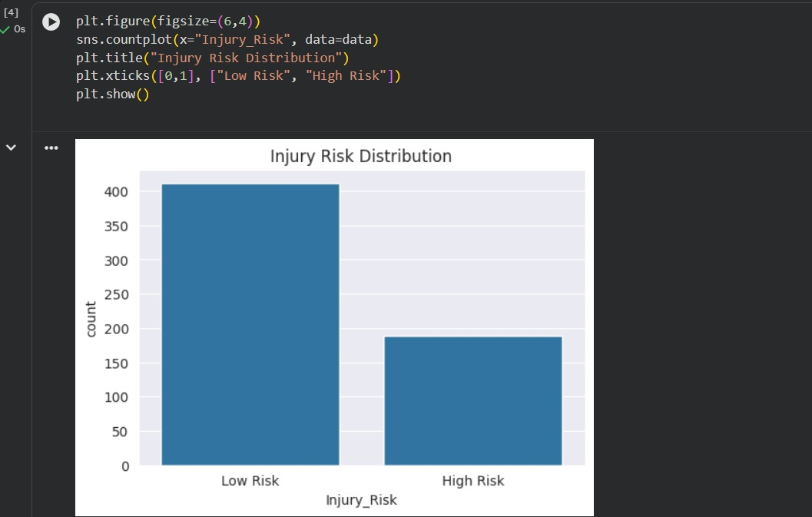
Count Plot (Bar Chart)
Data Visualisation
plt.figure(figsize=(6,4))
sns.countplot(x="Injury_Risk", data=data)
plt.title("Injury Risk Distribution")
plt.xticks([0,1], ["Low Risk", "High Risk"])
plt.show()
• The dataset shows more athletes in the Low Risk category compared to High Risk.
• This indicates a class imbalance, which must be considered during model training to avoid biased predictions.

Slide 12



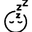









Feature Importance Analysis
Critical predictors identified through model interpretation
Training_Intensity
Weekly training volume and intensity
Sleep_Hours
Daily rest and recovery sleep
Injury_History
Past injury occurrences
Recovery_Time
Rest days between intensive sessions
Muscle_Asymmetry
Imbalance between left and right side strength
Clinical Insight
Prevention Strategy
Model Interpretability
Training intensity and inadequate sleep significantly increase injury probability. Recovery protocols must balance workload with adequate rest.
Monitor and moderate training loads, prioritize sleep hygiene, and address recovery deficits through planned rest and active recovery protocols.
Feature importance provides actionable insights, demonstrating model transparency and supporting coach-informed intervention strategies.
Notes:
1.7.2013
1.7.2013
‹#›
‹#›
‹#›

Slide 13
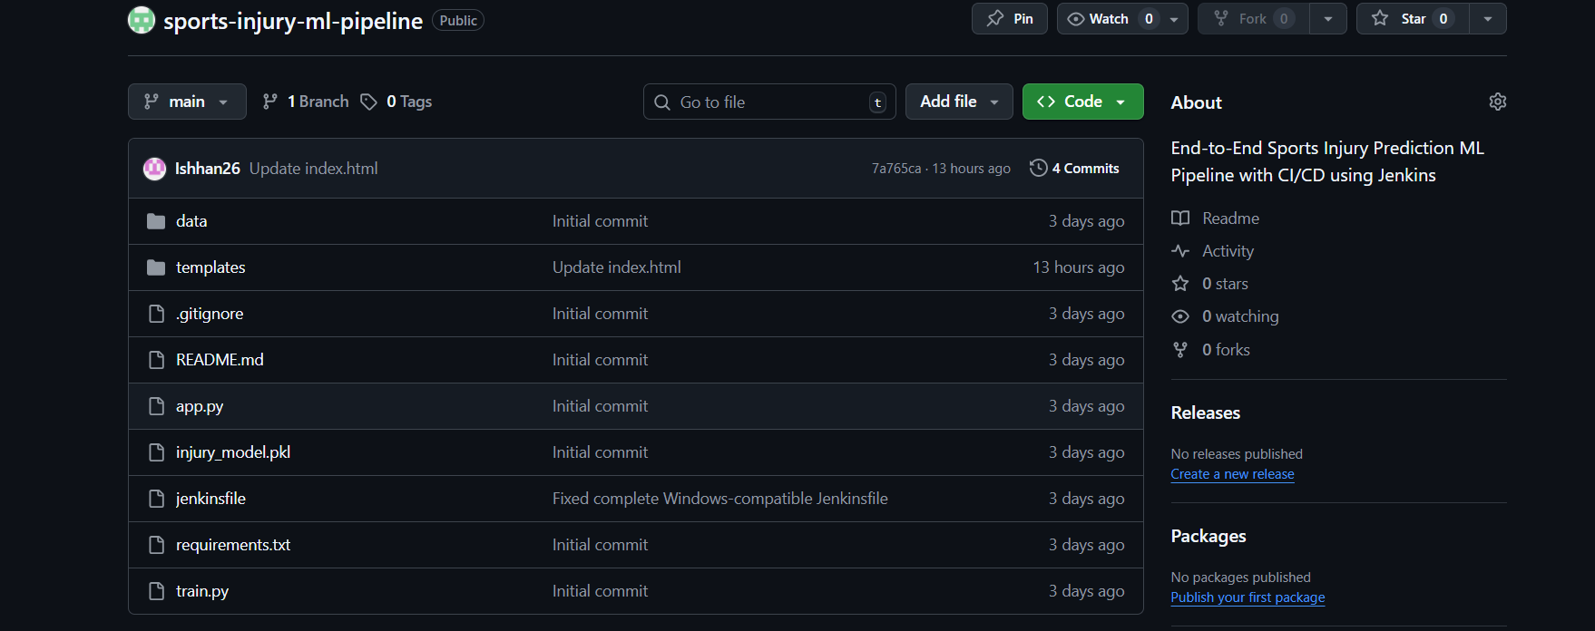
Github Integration
https://github.com/prxyansh27/sports-injury-ml-pipeline

Slide 14
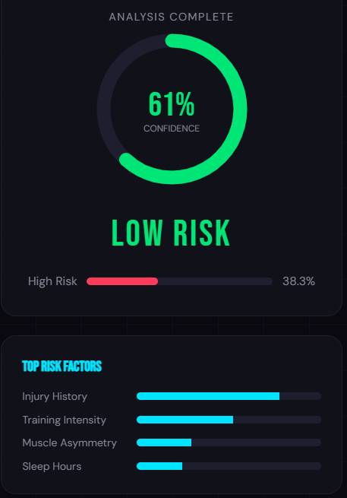
A Predictive Diagnostic Dashboard
💡 The Solution
This is an end-to-end web application that:
Analyzes 15 biometric and training-related variables
Uses a trained Machine Learning model
Uses a trained Machine Learning model
Calculates real-time injury risk percentage
Displays results instantly through an interactive dashboard
🧠 How It Works
Athlete data is entered into the system
The data is processed using Pandas and NumPy
A trained ML model (Random Forest) predicts injury probability
The system calculates risk percentage
The dashboard displays:
Risk Percentage
Risk Level (Low / Medium / High)
Immediate feedback

Slide 15
Future Enhancements & Conclusion
🚀 Future Enhancements
Integration with wearable devices for live data tracking
Deployment as a mobile application
Advanced models using Deep Learning
Real-time dashboard analytics & visualization
✅ Conclusion
Developed an end-to-end Machine Learning–based injury prediction system
Enables proactive and data-driven athlete management
Provides real-time injury risk percentage through an interactive dashboard
Demonstrates full-stack implementation with ML integration

Slide 16

Thankyou

